Slide 1

Movie Review Classification: Sentiment Analysis
This presentation explores the development and deployment of a movie review classification model leveraging sentiment analysis, a critical aspect of natural language processing.
Presented by:
Sarah Osama Mohamed Elfishawy.
Mahmoud Attya Mohamed Attya.
Yasmin Hamdy Mahmoud.
Lilian Stephanos Yonan.
Osama Hafez Fathy Hafez.

Slide 2

Problem definition
The project's objective is to create a sentiment analysis model that can effectively classify movie reviews from the IMDb dataset as positive or negative.
1
Sentiment Analysis
2
IMDb Dataset
Sentiment analysis plays a crucial role in various applications, including market analysis, brand monitoring, and gauging consumer opinions.
The IMDb dataset, containing a vast collection of movie reviews, serves as a valuable resource for training and evaluating the model.

Slide 3
Movie Classification Model Flowchart
Data Collection
1
The initial stage involves gathering movie reviews from IMDb, including both the textual content of the review and the associated sentiment label (positive or negative).
2
Data Preprocessing
Data preprocessing is essential for preparing the data for model training. This step involves cleaning the data by removing noise, such as punctuation, stop words, and irrelevant characters, and converting the text into a numerical format.
Model Training
3
The model is trained on the preprocessed data, utilizing machine learning algorithms to learn patterns and relationships between the text and sentiment labels.
4
Model Evaluation
The trained model is then evaluated on unseen data to assess its accuracy and generalizability.
Deployment
5
Once the model is deemed satisfactory, it is deployed, making it available for real-time predictions on new movie reviews.

Slide 4
Dataset Description
The project utilizes the IMDb Reviews dataset, a widely used resource for sentiment analysis tasks.
IMDb Reviews Dataset
Data Split
Textual Content & Labels
The dataset contains 50,000 movie reviews, each labeled as either positive or negative.
The dataset is divided into two subsets: a training set of 25,000 reviews and a test set of 25,000 reviews. This split allows for training the model on one set and evaluating its performance on an independent set.
Each review consists of free-form text expressing opinions about a specific movie. The labels associated with each review indicate whether the sentiment expressed is positive (1) or negative (0).

Slide 5
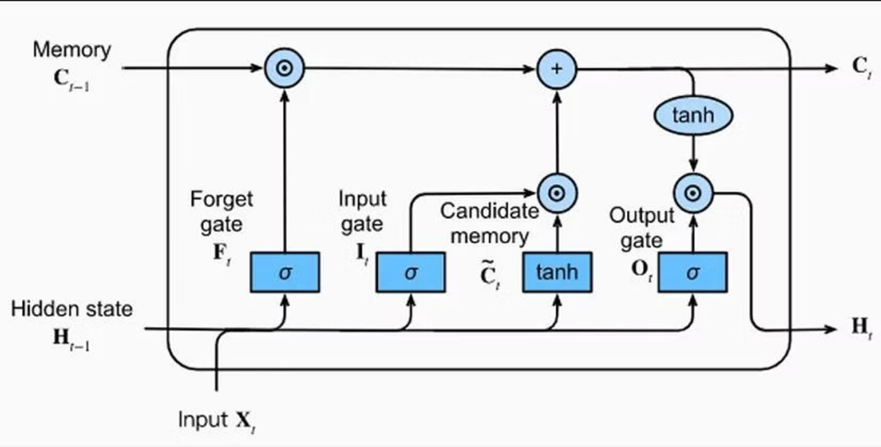
Model Architecture
1
Embedding Layer
This layer transforms integer-encoded words into dense vector representations, enabling the model to learn semantic relationships between words.
2
LSTM Layer
Long Short-Term Memory (LSTM) layers are designed to handle sequential data, such as text, by capturing long-term dependencies.
3
Dropout Layers
Dropout layers prevent overfitting by randomly setting a fraction of the input units to zero during training, forcing the model to rely on a variety of features.
4
Dense Layer & Output Layer
The dense layer adds a fully connected layer to learn complex representations, and the output layer provides the final classification output, predicting whether a review is positive or negative.

Slide 6

Training
The model is trained using a set of carefully chosen parameters to optimize its performance.
Loss Function
Binary Cross-entropy is suitable for binary classification tasks.
Optimizer
Adam optimizer, which adapts the learning rate during training.
Metrics
Accuracy to evaluate the model's performance.
Training Procedure
The model is trained for 5 epochs. The model is validated on a portion of the training data to monitor overfitting.
The model is trained for 5 epochs, and validation is performed on a portion of the training data to monitor for overfitting.

Slide 7
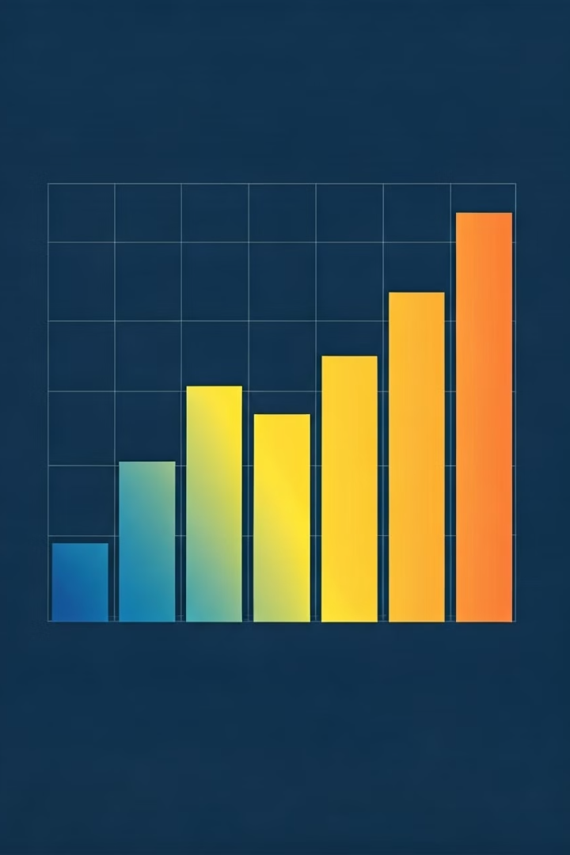


Evaluation
The trained model is evaluated on unseen data to assess its generalizability and performance.
Train Accuracy
Test Accuracy
The model achieves an impressive train accuracy of 99.99%.
The model demonstrates a test accuracy of 92%, indicating its ability to generalize well to unseen data.

Slide 8
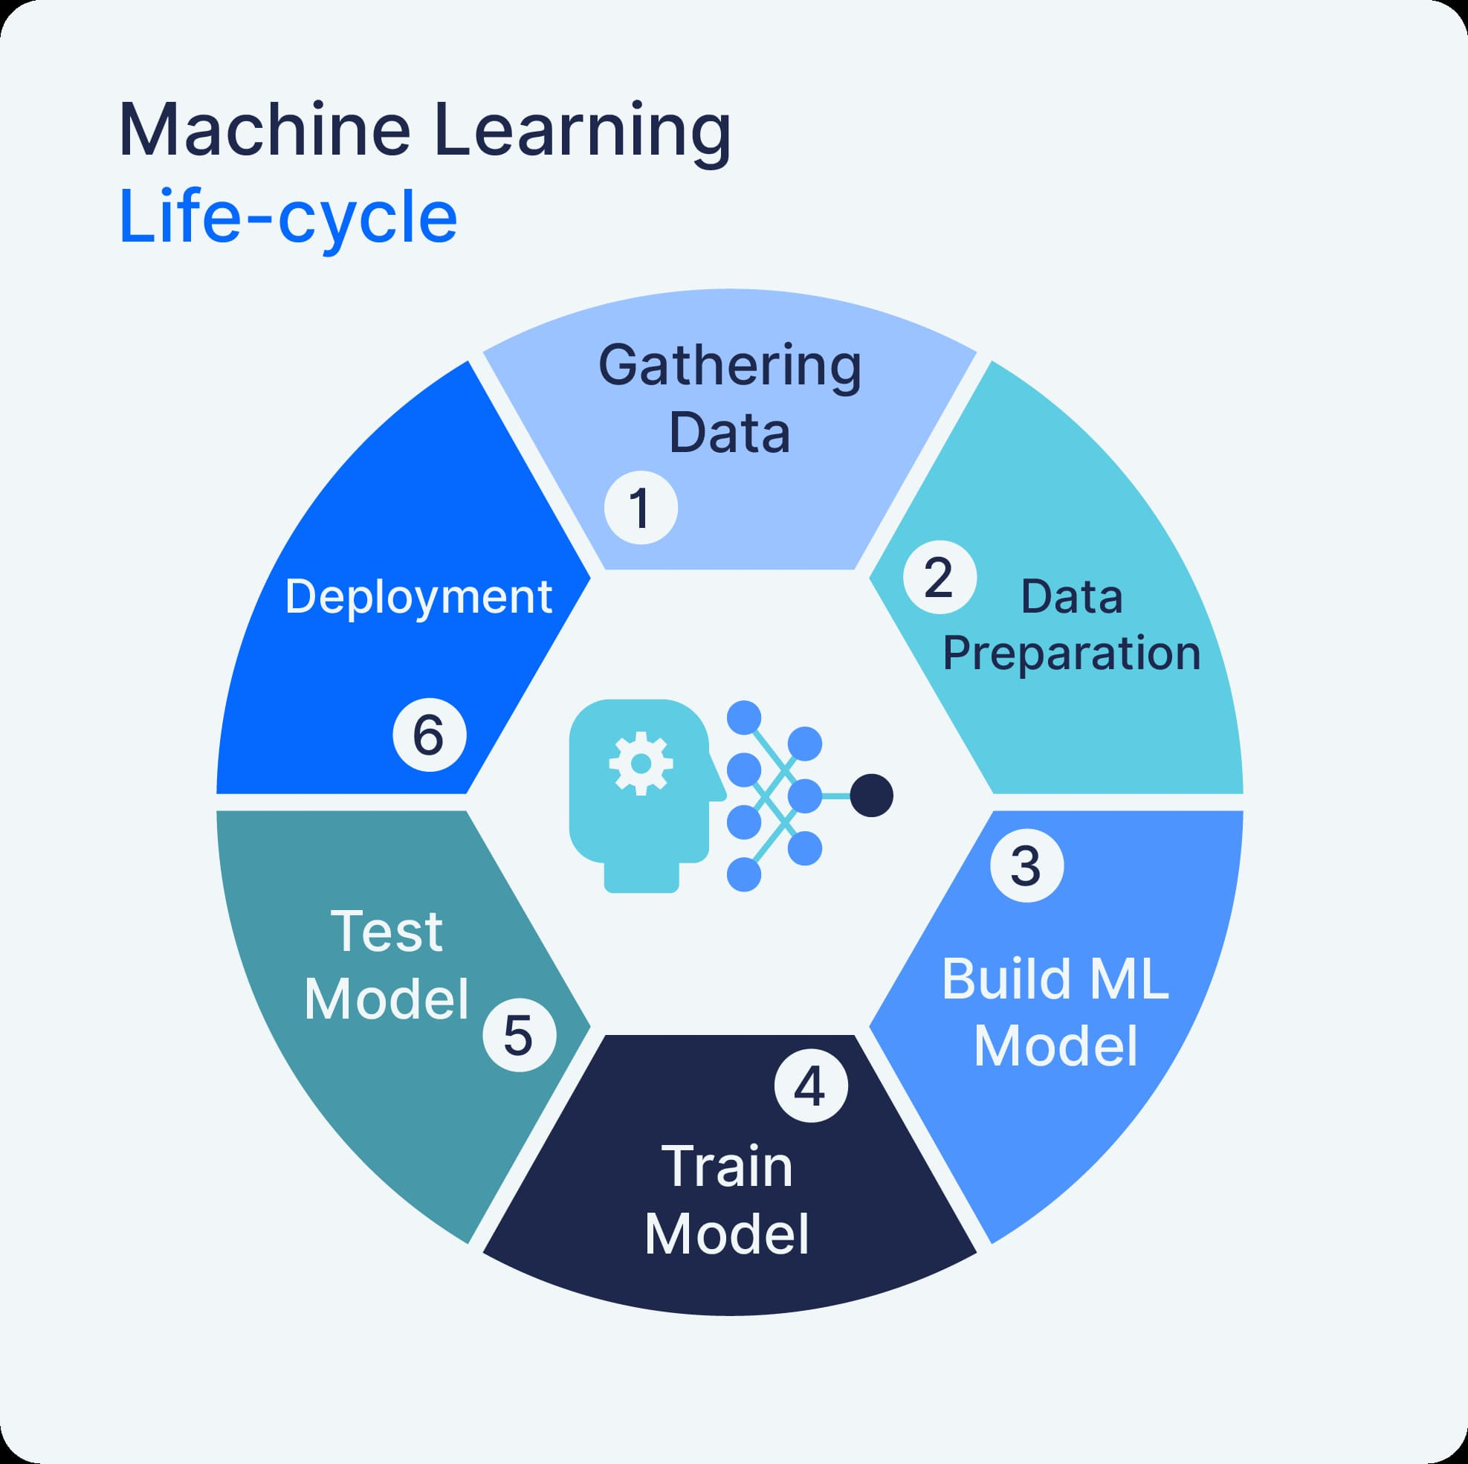



Deployment
The trained model is deployed to make it accessible for real-time
predictions.
Function Definition
A function, predict\_sentiment, is defined to preprocess input text and make predictions using the trained model.
Gradio Interface Creation
A user-friendly Gradio interface is created, providing text input for movie reviews and displaying the predicted sentiment as output.
Launching the Interface
The Gradio interface is launched, enabling users to interact with the deployed model and receive sentiment predictions in real time.

Slide 9
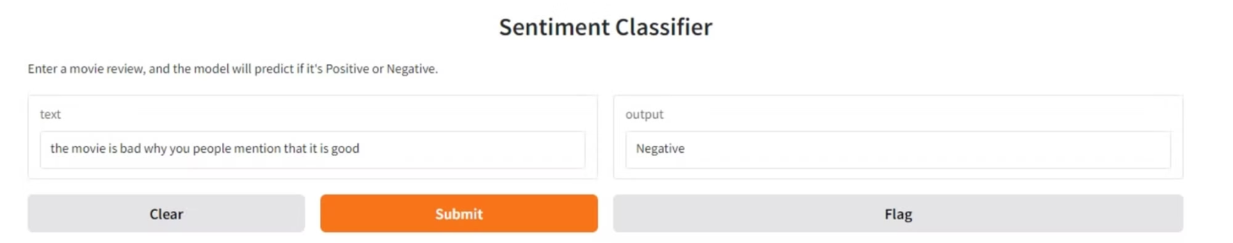
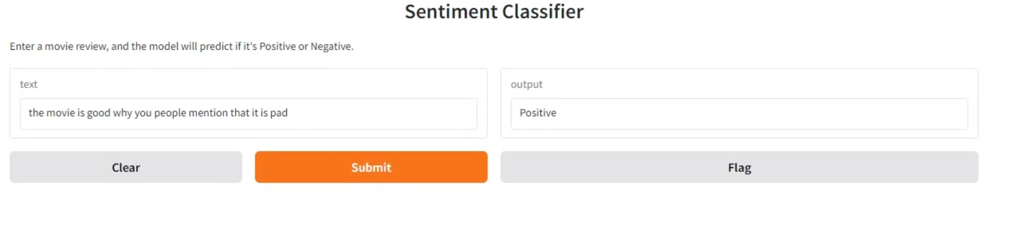
Example 1
Example 2
These examples showcase the model's ability to accurately classify movie reviews as positive or negative.

Slide 10
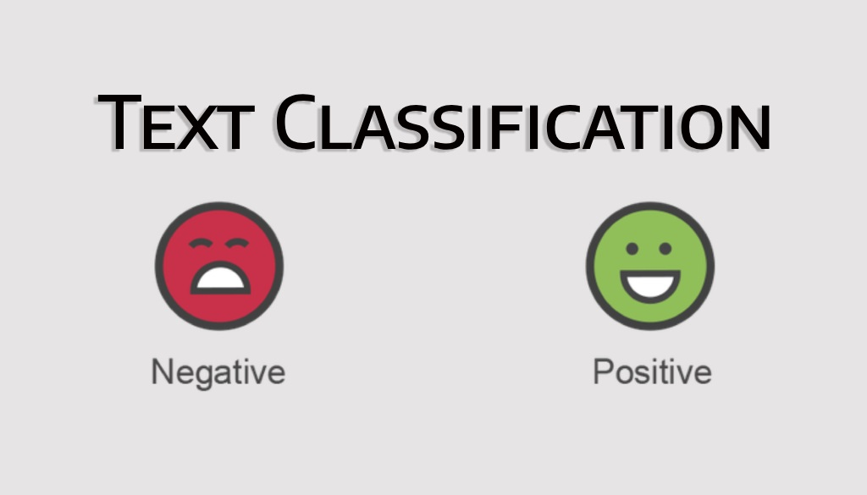
Conclusion
The text classification project successfully demonstrates the implementation of a sentiment analysis model using the IMDb dataset. By following a structured approach—from data preprocessing and model training to evaluation and deployment—the project highlights the capabilities of deep learning in understanding human sentiments through text.

Slide 11



Future Work
1
Model Improvement
2
Data Augmentation
Exploring more advanced architectures, such as transformers (e.g., BERT or GPT), could enhance the model's performance and ability to understand complex linguistic nuances.
Incorporating additional datasets or expanding the current dataset to include more diverse reviews may improve the model's robustness and generalizability.
3
Hyperparameter Tuning
Experimenting with different hyperparameters (e.g., learning rates, batch sizes) could further optimize the model's performance.

